Slide 1
Sequence Models

Slide 2
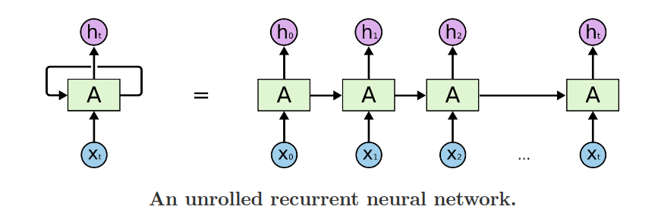
Recurrent Neural Network
Networks with loops
Allow information to persist
Multiple copies of same network

Slide 3
Problem
The clouds is in the …......?
Problems such as Speech Recognition or Time-series prediction require a system to store and use context

Slide 4
Introduction
It is a generalization of feed-forward neural network that has an internal memory
An RNN has short-term memory
short-term memory allows the network to retain past information
RNN is best suited for sequential data (audio, text, time series data)
in RNN, all the inputs are related to each other (inputs are independent in feed forward)

Slide 5
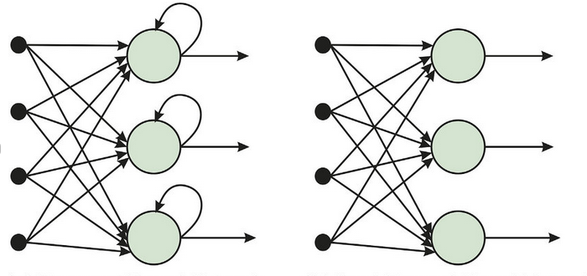
RNN vs Feed Forward Network

Slide 6
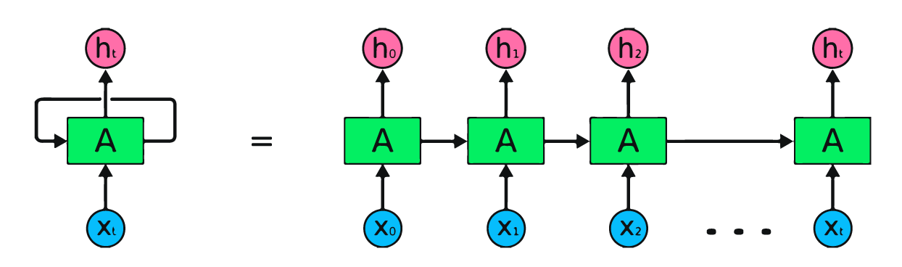

Slide 7
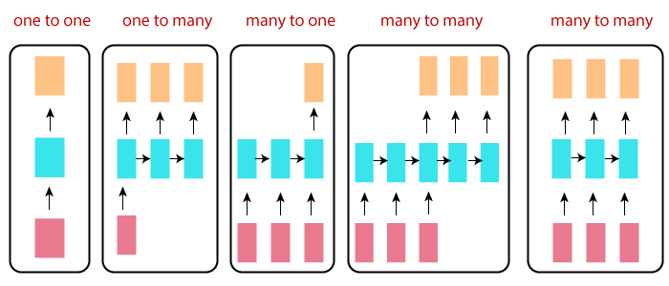
RNN Types

Slide 8
RNN Types
One to One RNN
It is the most basic and traditional type of Neural network
It is also known as Vanilla Neural Network
It is used to solve regular machine learning problems.

Slide 9
RNN types
One to Many
It is a kind of RNN architecture is applied in situations that give multiple output for a single input.
A basic example of its application would be Music generation.
In Music generation models, RNN models are used to generate a music piece(multiple output) from a single musical note(single input).

Slide 10
RNN Types
Many to one
is usually seen for sentiment analysis model as a common example.
As the name suggests, this kind of model is used when multiple inputs are required to give a single output.
The Twitter sentiment analysis model taskes text input (words as multiple inputs) gives its fixed sentiment (single output).

Slide 11
RNN Types
Many to many
Architecture takes multiple input and gives multiple output
Many-to-Many architecture can also be represented in models where input and output layers are of different size
The most common application of this kind of RNN architecture is seen in Machine Translation

Slide 12
Use Case
One to One: image Classification
One to Many: image captioning
Many to One: sentiment analysis
Many to Many: language translation

Slide 13
Advantages
An RNN remeners each and every information through time. It is useful in time series prediction only because of the feature to remember previous inputs as well. This is called Long Short Term Memory
RNN are even used with convolutional layers to extend the effective pixel

Slide 14
Disadvantages
Gradient vanishing and exploding problems
Training RNN is very difficult task
It cannot process very long sequences if using tanh or resu as activation funvtion

Slide 15
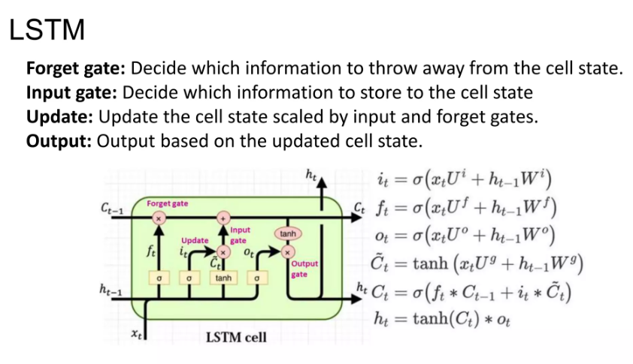
Long Short Term Memory (LSTM) Networks

Slide 16
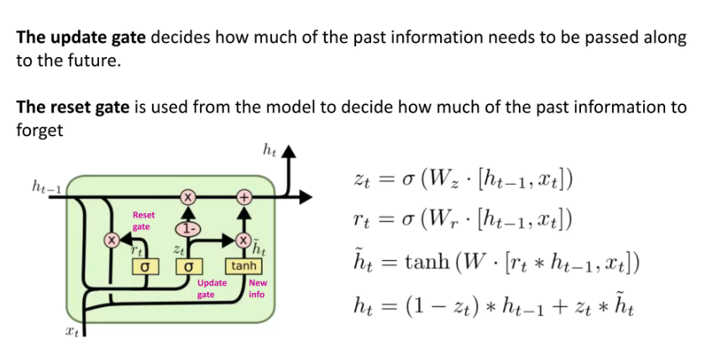
GRU

Slide 17
Components of LSTM
Forget gate
Input gate
Output gate
Cell state
Activation function
Sigmoid
TanH

Slide 18
Components of LSTM
Forget gate
Decides which information should be kept and which should be discarded
Input gate
Updates the cell state.
Output gate
Decides what the next hidden state(contains information on previous inputs) should be.
Cell state
Acts as a highway that transports relative information along the sequence chain.
Activation function
Sigmoid - squishes values between 0 and 1.
TanH - squishes values between -1 and 1.

Slide 19
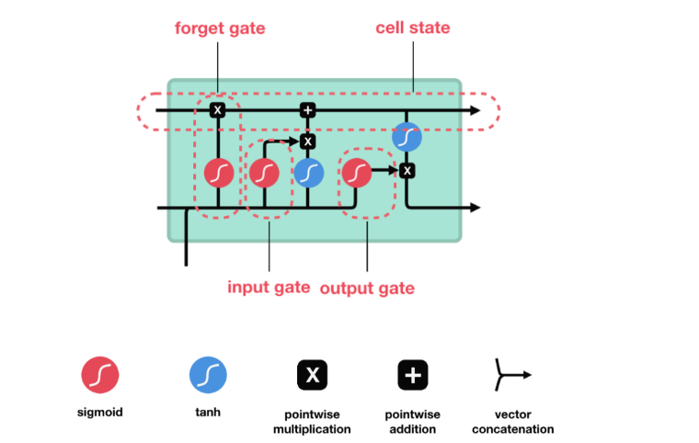
Figure

Slide 20
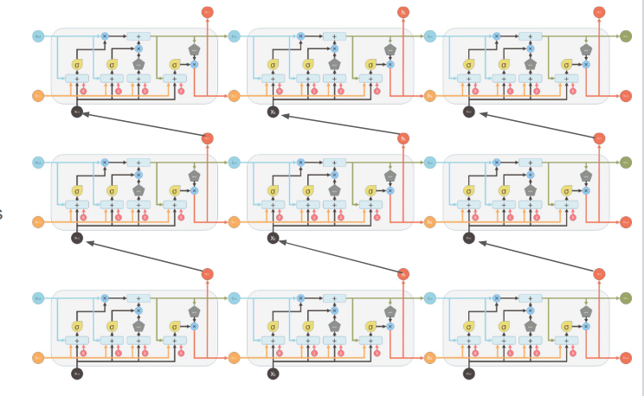
Figure

Slide 21
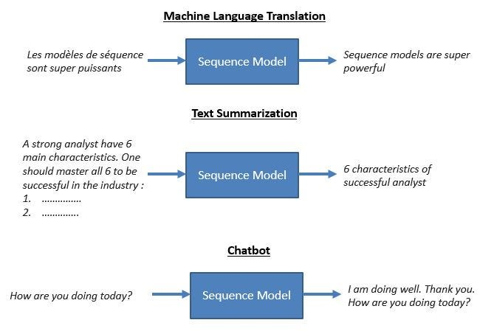

Slide 22
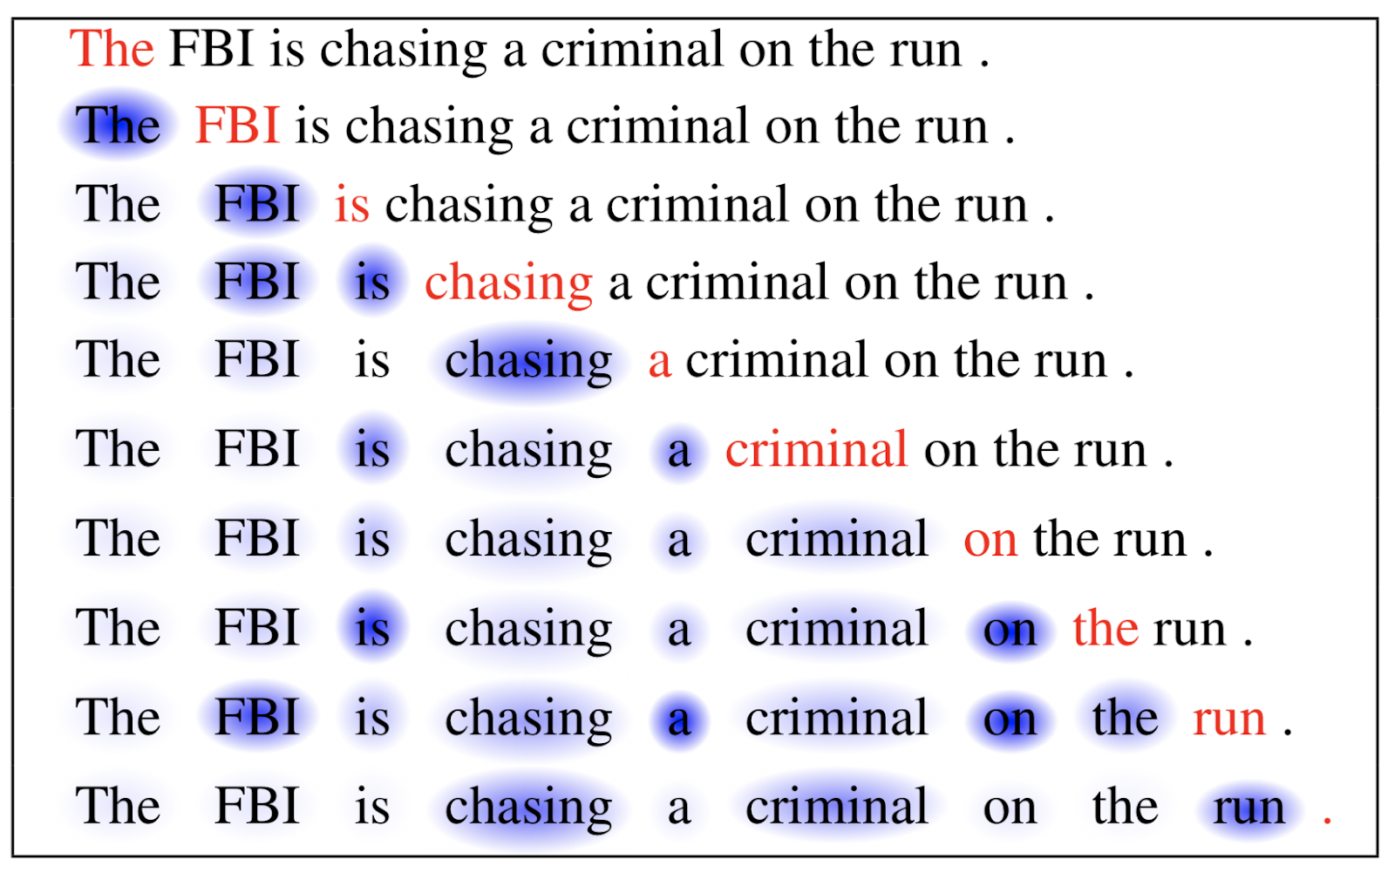
Attention

Slide 23
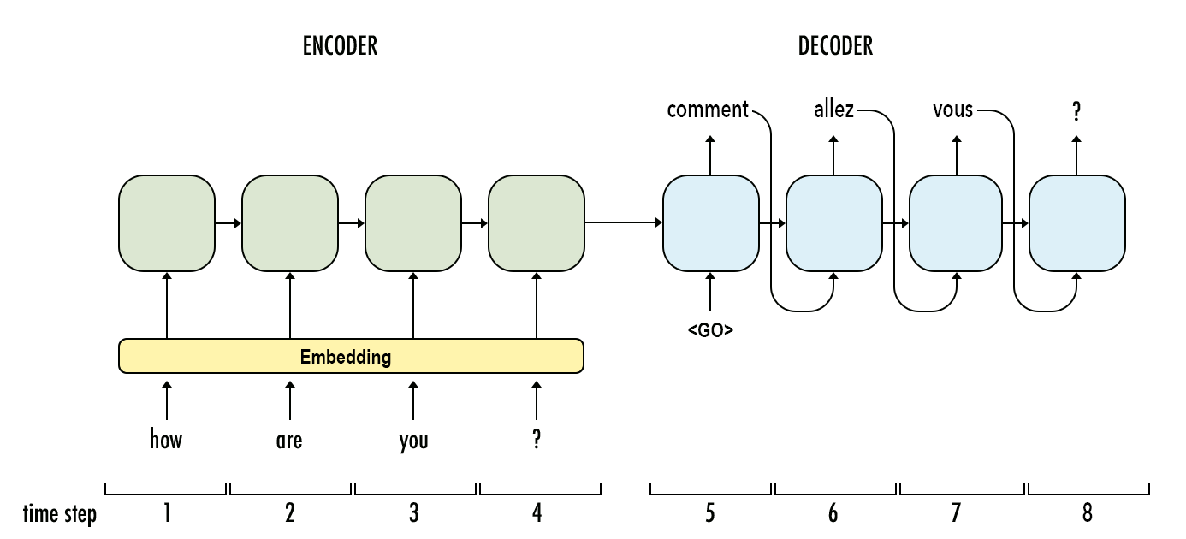

Slide 24
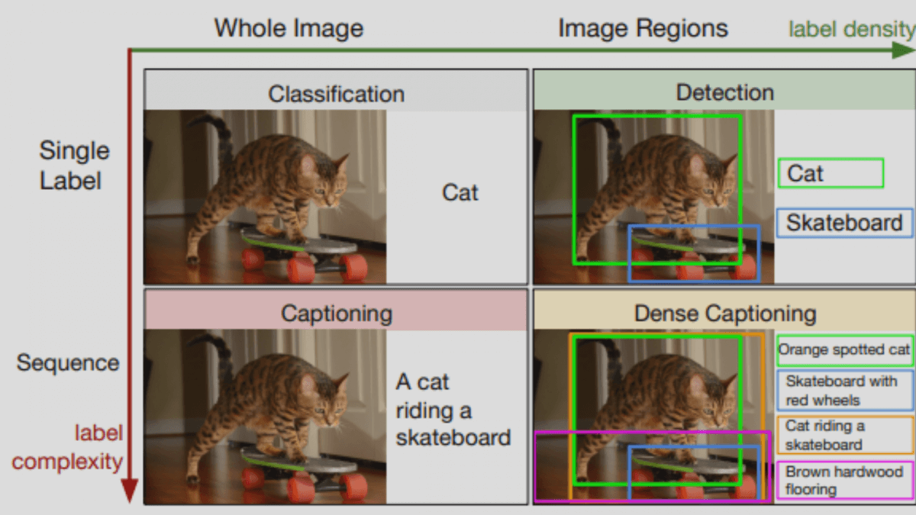
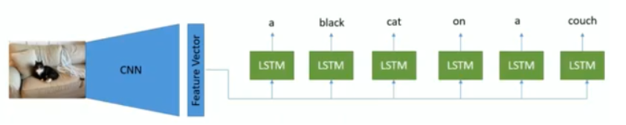

Slide 25
Demo

